Slide 1
Information Network at Graduate School of International Cultural Studies (GSICS)
Orientation for new students
October 2022
Hiroyuki Eto (Chief of Staff, GSICS Information Network System)

Slide 2
1. How to Use the GSICS Network
Connecting to the network
*The network (LAN) available to all courses in the GSICS is managed by each course.
*Please be sure to report the following items when you connect your computer to the network:
(1) Computer make and model (e.g., laptop vs. desktop)
(2) OS (e.g., Windows 11)
(3) Physical address of the computer (MAC address) -> Individual identification number of the computer
(4) Anti-virus software
*Do not connect to the network with a PC that is no longer supported by security, such as Windows XP or Windows 7.
*When connecting via wireless LAN, be sure to use the wireless LAN router (hub) of the course to which you belong. Do not use routers of other courses. Education roaming (eduroam) is being developed for use throughout the university. It is available in some areas.
Diagram of the graduate school network
VLAN
Major Field of Study A
Major Field of Study B
Note:
In the event of a serious problem on the network, steps may be taken to disconnect the entire course, including the offending computer, from the LAN. Therefore, one person's carelessness can cause serious damage to the entire major field of study and possibly to the entire Graduate School.
Wireless router

Slide 3
2. Precautions for using the Internet
Protect your computer from viruses and other malware:
Be sure to install security software such as anti-virus and firewall.
Tohoku University Academic/All-round/Advanced Information Network System (TAINS http://www.tains.tohoku.ac.jp/) distributes security software free of charge to users on campus.
Security software and OS must be constantly updated to be of any use.
Even PCs that are not connected to the GSICS network can be infected by viruses through USB memory sticks and other means. Be sure to have anti-virus protection on your home computer as well.
Even if you do not open a file containing a virus, depending on your computer settings (if Java Script or ActiveX is enabled), you may be infected with a virus or have your data stolen just by accessing a website.
Note:
*Do not leave security software installed and always update it to the latest version.
* If you discover that your computer is infected with a virus, disconnect it from the network immediately and report it to your advisor and/or course chair.

Slide 4
3. Risk of copyright infringement
Use of file-sharing software such as Winny is strictly prohibited.
Do not download e-journals illegally.
Even if you access e-journal sites from Google or other search engines without using the library portal site, as long as you access from the campus network, it will be treated the same as accessing from the library portal site. If it is judged as abuse, you will not be able to use the e-journals, which will cause a great deal of inconvenience to Tohoku University.
★ Please be sure to consult Computer Network Guideline for Security and Ethical Conduct can be accessed from the “Current Students > Student Life” page of the GSICS website.

Slide 5
4. Tohoku University Mail
"Tohoku University Mail” switched to G Suite for Education (“G Suite”) provided by Google, Inc. on June 17, 2019.
In G Suite, the email function is "Gmail," which can be used from anywhere on or off campus as long as there is an Internet connection and a browser.
In terms of functionality, the service is more convenient than ever, with enhanced security including anti-spam and anti-virus measures, as well as no limit on mailbox capacity.
How to use G Suite
The following sites provide information on how to use the various features of G Suite more conveniently.
https://support.google.com/a/users/answer/9296686#!/

Slide 6
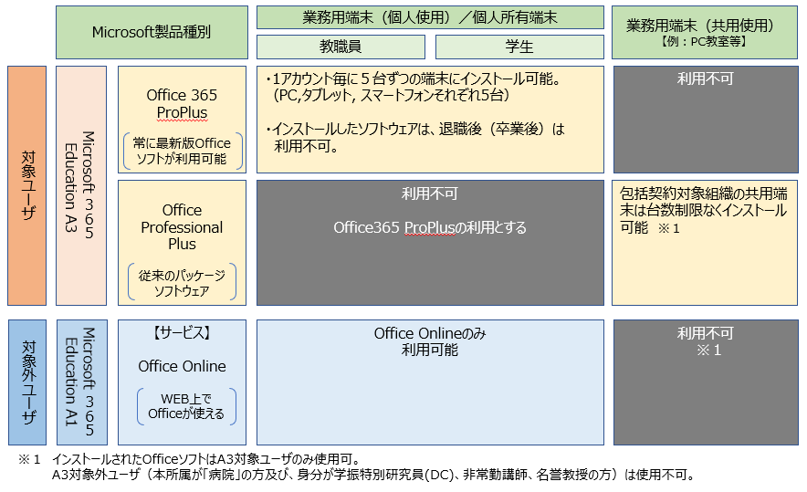
5. Risk of copyright infringement
*Tohoku University as a whole began offering the "Microsoft Comprehensive Agreement" in July 2020.
*In addition to the latest Windows OS and Office software, CAL (Client Access License) is also available.
*This service is available to all faculty, staff and students.
Products
PC（Institutional Use(Private) / Personal Use)
PC（Institutional Use :Shared Use )
Faculty Member
Student
Target
User
You can install Office 365 on five devices (PC, Smartphone, Tablet PC) for every account.
N/A
The latest Office software is available.
The installed software is unavailable after graduation or retirement from Tohoku University.
N/A
The institution's shared PC installation is not limited. ※1
Please use office365 ProPlus
Existing Packaging Software
N/A
Service
Office Online is only available
N/A
※1
This is only available on the Web.
※1 The installed Office SW is only available to A3 users.
Not-available to non-A3 Users
*For more information on the services offered, please visit the following website:
https://www.cds.tohoku.ac.jp/wordpress/wp-content/uploads/2022/03/Office365QuickGuidePC_eng20220401.pdf

Slide 7
Again: - Do not connect a computer with an OS whose security support has expired to the network. - Install the latest version of security software on your computer. - If your computer is infected with a virus, disconnect it from the network and report it immediately. - Never make illegal copies or unauthorized downloads. - Do not use the campus network for any purpose other than study and research.

Slide 8
Thank you for your attention.

