Slide 1
Orientation for New Students
Fall 2023
Graduate School of International Cultural Studies Tohoku University

Slide 2
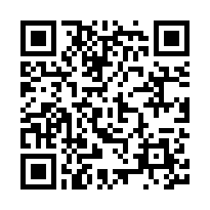
Online bulletin board for students
Important information from the Academic Affairs Office will be posted on the online bulletin board and it will also be sent to your Tohoku University DC mail.
Please be sure to check the online bulletin board and the mailbox of your DC email account (…@dc.tohoku.ac.jp) at least once a day.
Prepare your Tohoku University DC mail address and password in advance to be able to access the web page.
Online bulletin board for students:
https://sites.google.com/tohoku.ac.jp/intcul-student-99info-board-e/

Slide 3
Important notice: due to coronavirus, detailed procedures are subject to change this year.
Please be sure to check the mailbox of your DC email account (…@dc.tohoku.ac.jp) at least once a day and ask your supervisor and the office for any questions.
Be reminded that if you have relevant symptoms including a high fever, you need to refrain from coming to school.

Slide 4
In this session, the following are the main subjects.
(1) curriculum
(2) schedule
(3) other important information

Slide 5
curriculum

Slide 6
FOR MASTER STUDENTS
(1) curriculum
To complete the Master Program,
you are required to
earn 30 units (pass 15 courses)
and
submit a Master’s thesis

Slide 7
(1) Curriculum/Master
For Master Students:
Core courses (compulsory): 10 credits
・ English-language Skill for Research (2 credits)
・ Ethics for Academic Research (2 credits)
・ International Political Economy (2 credits)
・ Methodology of Investigation (2 credits)
As for the remaining one course (2 credits), you are required to choose at least one from the "specialized" courses which are "elective (designated).“
Elective courses: 16 credits
Seminars: 4 credits

Slide 8
Course Registration
(1) Curriculum/Master
To register for courses, you must:
use the Student Affairs Information System and register for your courses online.
complete registration between October 2 (Mon) and October 16 (Mon).
Please read the course syllabi and the timetable in deciding which courses to take.

Slide 9
(1) Curriculum/Master
・ Ethics for Academic Research
This is a compulsory course, and is offered as one of intensive lectures in the second term of the academic year 2023; the details are to be announced.
When ready, the schedule and the information on registration will be posted on the website.

Slide 10
FOR DOCTORAL STUDENTS
(1) Curriculum/Doctor
To complete the Doctoral Program,
you must
earn 12 units (pass 6 courses)
advanced research A/B, advanced seminar A/B, advanced lecture A/B
and
submit a doctoral dissertation
Important: Prior to the submission of the dissertation, the students are required to have two or more papers published in academic journals (at least one of those journals must be a prominent one).

Slide 11
Course Registration
(1) Curriculum/Doctor
To register for courses, you must:
use the Student Affairs Information System and register for your courses online.
complete registration between October 2 (Mon) and October 16 (Mon).

Slide 12
Schedule

Slide 13
Important events in the 2 years for Master students
(2) Schedule/Master
The 1st semester
Submit the “Research Title” Form (the end of December)
Give a “Research Title” presentation (late January)
End of the 3rd semester
Give a “Thesis Plan” presentation
During the 4th semester
Submit the Master’s thesis along with the “Master’s Thesis Title Registration” form
Give a presentation on your Master’s thesis
Pass the oral examination (Defense)

Slide 14
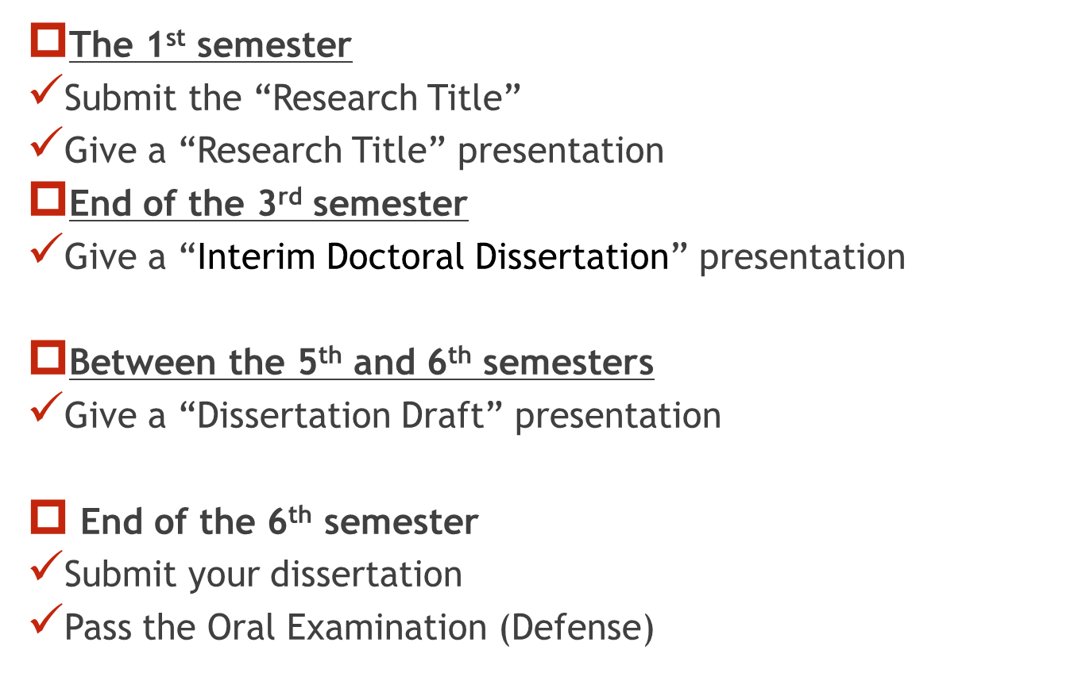
Important events in 3 years for Doctoral students
(2) Schedule/Doctor
Publish at least two academic papers

Slide 15
Academic portfolios for Doctoral students
(2) Schedule/Doctor
The purpose of the portfolio is to:
1) show a clear roadmap to the doctoral degree.
2) help the students manage their own preparations and progress in an organized manner.
3) review the student’s research plan and timeline and make changes as appropriate.
Student portfolios are created in Google Classroom.
You are registered as a student in your own classroom.
Please follow the instructions from the Academic Affairs Office
for more details about how to use the classroom.

Slide 16
Other information

Slide 17
(3) Other Information
The school’s website must be checked daily.
When you are sick, you can visit the health management center on campus (the nearest one is on Kawauchi North Campus, see the Student Handbook at page 10). Bring your health insurance card with you.
Consultation services: see pages 55-56

Slide 18
(3) Other Information
On Information Security
When using a PC or any electronic device connected to the university’s network
Please be aware that you are using public property;
Never use a P2P file sharing software;
Do not engage in any conducts violating copyright laws;
Do not make other illegal/improper use of network

Slide 19
(3) Other Information
When you have any questions or inquiries, contact your advisor/supervisor, tutor, or staff members in the Academic Affairs Office.
When contacting the Academic Affairs Office, please use your Tohoku University email account (…@dc.tohoku.ac.jp) and avoid using a personal email address
The Academic Affairs Office is located on the 2nd floor of the Graduate School Building, and is open on weekdays from 8:45 to 17:15. (Lunch break: 12:30-13:00).
Due to the current situation, please contact the office by email at int-kkdk@grp.tohoku.ac.jp if you have any questions or inquiries.

Slide 20
(3) Other Information
In order to obtain your Tohoku-dai ID and password, please refer to the confirmation page at the following link and login using your temporary ID (examinee number) and password.
https://www.bureau.tohoku.ac.jp/i-synergy/conid/

Slide 21
This is the end of the orientation
We warmly welcome you to
Graduate School of International
Cultural Studies, Tohoku University
We hope you will have a wonderful time here

